Slide 1
Lecture 3 Testbenches
Tian Sheuan Chang

Slide 2
Outlines
Overview of design verification
Testbench example
Information display and file I/O
High level constructs

Slide 3
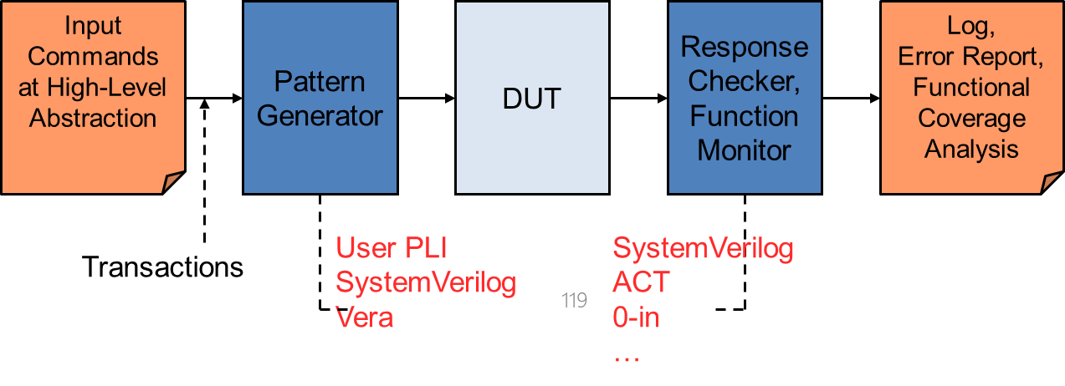
Overview
HDL that tests another module: device under test (dut)
You will need to
Instantiate DUT
Generate test pattern
Clock and reset signals
Input signals by manual design or file
Prefer self auto or semi-auto stimulus generation
Check responses if meet the golden answer
Compare DUT output with golden data
Golden data either by manual design or file
Prefer self automatic response checking

Slide 4
Input
Commands
at High-Level
Abstraction
Pattern
Generator
DUT
Response
Checker,
Function
Monitor
Log,
Error Report,
Functional
Coverage
Analysis
Transactions
Instantiate DUT (device under test, aka. Your design)
Generate test pattern
Clock and reset signals
Input signals by manual design or file
Prefer self auto or semi-auto stimulus generation
Check responses if meet the golden answer
Compare DUT output with golden data
Golden data either by manual design or file
Prefer self automatic response checking

Slide 5
How to Start Your Own Testbench
Start with the testbench template examples
Basic one:
// CLOCK GENERATION
// RESET
// INITIALIZATION
// SEND STIMULUS & MAIN FLOW
// CHECK RESPONSE
// no reset outputs
// wrong answer
Notes:
Show example
pattern in lab1

Slide 6
How to Start Your Own Testbench
INPUT.txt
Stimulus
generator
Best one for complex design
File I/O with behavior model
Example
initial begin //golden file input
file2 = $fopen("input.txt","r");
end
for(j=0;j<input_num[i];j=j+1) begin
rc=$fscanf(file2,"%d",data_in[j]);
end
@(negedge CLK); //automatic checking
for(k=1;k<(input_num[i]+1);k=k+1) begin
if(OUT!==golden_ans[k]) begin
Error = 1'b1;
your_out[k-1] = OUT;
$display (" Error !! OUTPUT IS WRONG! ");
…………………
Golden model in C
Design
Golden
OUTPUT.txt
Response checker
Notes:
Pattern in lab3, 2017

Slide 7
Testbench example

Slide 8
Testbenches Coding
Not synthesizeable, use high level commands to facilitate this
initial block
Delay for n units of time
Full high-level constructs: if, while, sequential assignment.
Input/output: file I/O, output to display, etc.
Test pattern
Manual design
From files
Output check
Self checking

Slide 9
Test Pattern Structure
Must have
Clock generation
Reset signal generation
Signal initialization
Pattern generation
Manual design
Read from file (Verilog specific, $readmemh, C-like file I/O, e.g. $fscanf)
Response checker
Manual design
Auto or semi-auto check with golden data from file
Post-processing with C or matlab

Slide 10
I. A Simple Test Bench
`timescale 1ns/1ps
module test_bench;
// Interface to communicate with the DUT reg a, b, clk;
wire c;
// Device under test instantiation
DUT U1 (.in1(a), .in2(b), .clk(clk), .out1(c));
initial
module DUT (in1, in2, clk, out1); input in1, in2;
input clk; output reg out1;
always @(posedge clk) out1 = in1^in2; endmodule
begin // Test program
test1 (); //call input pattern task
$finish; //terminate simulation
end
initial begin
clk = 0;
forever #5 clk = ~clk; end
initial
begin // Monitor the simulation
$dumpvars;
$display ("clk | in1| in2 | out1 |");
task test1 ();
begin
a = 0;
b = 0;
b = 1;
b = 1;
b = 0;
#10 a = 0;
#10 a = 1;
#10 a = 1;
end
endtask
$monitor (" %b| %b | %b | %b |",clk, a, b, c); end
endmodule

Slide 11
II. Another Testbench Example
Write SystemVerilog code to implement the following function in hardware:
y = bc + ab
Name the module sillyfunction

Slide 12
II.
Write SystemVerilog code to implement the following function in hardware:
y = bc + ab
module sillyfunction(input logic a, b, c,
output logic y);
assign y = ~b & ~c | a & ~b;
endmodule

Slide 13
II.A Simple Testbench by Manual Design Pattern (手工測資)
module testbench1();
logic a, b, c;
logic y;
// instantiate device under test
sillyfunction dut(a, b, c, y);
// apply inputs one at a time
initial begin
a = 0; b = 0; c = 0; #10;
c = 1; #10;
b = 1; c = 0; #10;
c = 1; #10;
a = 1; b = 0; c = 0; #10;
c = 1; #10;
b = 1; c = 0; #10;
c = 1; #10;
$finish; //terminate the simulation
end
endmodule

Slide 14
II.B Self-checking Testbench
module testbench2();
logic a, b, c;
logic y;
sillyfunction dut(a, b, c, y); // instantiate dut
initial begin // apply inputs, check results one at a time
a = 0; b = 0; c = 0; #10;
if (y !== 1) $display(“000 failed.”); //每個都比對一下正確答案
c = 1; #10;
if (y !== 0) $display("001 failed.");
b = 1; c = 0; #10;
if (y !== 0) $display("010 failed.");
c = 1; #10;
if (y !== 0) $display("011 failed.");
a = 1; b = 0; c = 0; #10;
if (y !== 1) $display("100 failed.");
c = 1; #10;
if (y !== 1) $display("101 failed.");
b = 1; c = 0; #10;
if (y !== 0) $display("110 failed.");
c = 1; #10;
if (y !== 0) $display("111 failed.");
$finish;
end
endmodule

Slide 15
III. Testbench with Testvectors 測資從檔案來
Testvector file: inputs and expected outputs
Testbench:
Generate clock for assigning inputs, reading outputs
Read testvectors file into array
Assign inputs, expected outputs
Compare outputs with expected outputs and report errors

Slide 16
Testbench clock:
assign inputs (on rising edge)
compare outputs with expected outputs (on falling edge).
Testbench clock also used as clock for synchronous sequential circuits

Slide 17
Testvectors File
File: example.tv
contains vectors of abc_yexpected
input_output
000_1
001_0
010_0
011_0
100_1
101_1
110_0
111_0

Slide 18
1. Generate Clock
module testbench3();
logic clk, reset;
logic a, b, c, yexpected;
logic y;
logic [31:0] vectornum, errors; // bookkeeping variables
logic [3:0] testvectors[10000:0]; // array of testvectors
// instantiate device under test
sillyfunction dut(a, b, c, y);
// generate clock
always // no sensitivity list, so it always executes
begin
clk = 1; #5; clk = 0; #5;
end

Slide 19
2. Read Testvectors into Array
// at start of test, load vectors and pulse reset
initial
begin
$readmemb("example.tv", testvectors);
vectornum = 0; errors = 0;
reset = 1;
#27;
reset = 0;
end
// Note: $readmemh reads testvector files written in
// hexadecimal

Slide 20
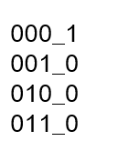
3. Assign Inputs & Expected Outputs
// apply test vectors on rising edge of clk
always @(posedge clk)
begin
#1; {a, b, c, yexpected} = testvectors[vectornum];
end
input
Golden data

Slide 21
4. Compare with Expected Outputs
// check results on falling edge of clk
always @(negedge clk)
if (~reset) begin // skip during reset
if (y !== yexpected) begin
$display("Error: inputs = %b", {a, b, c});
$display(" outputs = %b (%b expected)",y,yexpected);
errors = errors + 1;
end
// Note: to print in hexadecimal, use %h. For example,
// $display(“Error: inputs = %h”, {a, b, c});

Slide 22
4. Compare with Expected Outputs
// increment array index and read next testvector
vectornum = vectornum + 1;
if (testvectors[vectornum] === 4'bx) begin
$display("%d tests completed with %d errors",
vectornum, errors);
$finish;
end
end //end of always
endmodule
// === and !== can compare values that are 1, 0, x, or z.

Slide 23
Delays
module example(input logic a, b, c,
output logic y);
logic ab, bb, cb, n1, n2, n3;
assign #1 {ab, bb, cb} =
~{a, b, c};
assign #2 n1 = ab & bb & cb;
assign #2 n2 = a & bb & cb;
assign #2 n3 = a & bb & c;
assign #4 y = n1 | n2 | n3;
endmodule

Slide 24
module example(input logic a, b, c,
output logic y);
logic ab, bb, cb, n1, n2, n3;
assign #1 {ab, bb, cb} =
~{a, b, c};
assign #2 n1 = ab & bb & cb;
assign #2 n2 = a & bb & cb;
assign #2 n3 = a & bb & c;
assign #4 y = n1 | n2 | n3;
endmodule
1

Slide 25
module example(input logic a, b, c,
output logic y);
logic ab, bb, cb, n1, n2, n3;
assign #1 {ab, bb, cb} =
~{a, b, c};
assign #2 n1 = ab & bb & cb;
assign #2 n2 = a & bb & cb;
assign #2 n3 = a & bb & c;
assign #4 y = n1 | n2 | n3;
endmodule
2

Slide 26
module example(input logic a, b, c,
output logic y);
logic ab, bb, cb, n1, n2, n3;
assign #1 {ab, bb, cb} =
~{a, b, c};
assign #2 n1 = ab & bb & cb;
assign #2 n2 = a & bb & cb;
assign #2 n3 = a & bb & c;
assign #4 y = n1 | n2 | n3;
endmodule
2

Slide 27
module example(input logic a, b, c,
output logic y);
logic ab, bb, cb, n1, n2, n3;
assign #1 {ab, bb, cb} =
~{a, b, c};
assign #2 n1 = ab & bb & cb;
assign #2 n2 = a & bb & cb;
assign #2 n3 = a & bb & c;
assign #4 y = n1 | n2 | n3;
endmodule
4

Slide 28
IV. Simple testbench (SystemVerilog Version)
Defines the time units and simulation precision (smallest increment)
`timescale <reference_time_unit> / <time_precision>
reference_time_unit: simulation time unit
time_precision: unit for rounding
The precision unit must be less than or equal to the time unit
`timescale 1ns/1ps //time resolution
`include “design.v”
`include “pattern.v”
module testbench;
// inter connection wire
wire clk_p;
wire rst_n;
wire [7:0] data_in;
wire [7:0] data_out;
// connect test pattern
pattern U_pattern(
.*);
//my test
design U_design(
.*));
// dumpping waveform
initial begin
$fsdbDumpfile(“waveform.fsdb”);
$fsdbDumpvars;
end
endmodule
`ifdef RTL
`timescale 1ns/100ps
`endif
//finer resolution for gate level
`ifdef GATE
`timescale 1ns/10ps
`endif
//global parameters for all modules
`define CLK_PERIOD 30.0

Slide 29
//--------------------------------------------------
// CLK DECLARATION
//---------------------------------------------------
logic clk;
parameter cycle = 15;
initial begin
clk=0;
forever #(cycle/2.0) clk = ~clk;
end
Another coding style
Another coding style
module testbench;
...
logic clk = 0;
parameter cycle = 15;
always
begin
#(cycle/2.0); // if int division => 7
clk =~clk;
end
endmodule
always // no sensitivity list, so
//it always executes
begin
clk = 1; #5; clk = 0; #5;
end
Notes:
Clock generation
Initial setting
Always on with half 0 and 1

Slide 30
Note. task
A task: pack common operations into one
Defined in module, not synthesizable
Can be called by any procedural block.
Has n input, m output.
Can include timing control like wait, @, #
Ex
// calling
increase(A, B);
// declaration
task increase;
input [4:0] b;
output [4:0] a;
begin
a = #5 b + 1;
end
endtask
Notes:
把常用的動作打包，方便呼叫
可以有delay 或timing 控制 (wait, @..)

Slide 31
Note. function
A function: pack common combinational operations into one
Defined in module, synthesizable
Can be called by function but not task
Has n inputs, 1 output
Cannot include timing control.
Execute no delay.
Example
// calling
C = increase(B);
// declaration
function increase;
input [4:0] b;
begin
increase = b + 1;
end
endfunction
output
Notes:
把常用的功能打包，方便呼叫
純combinational logic
不可以有delay 或timing 控制 (wait, @..)
只有一個輸出
可以用在可合成的設計

Slide 32
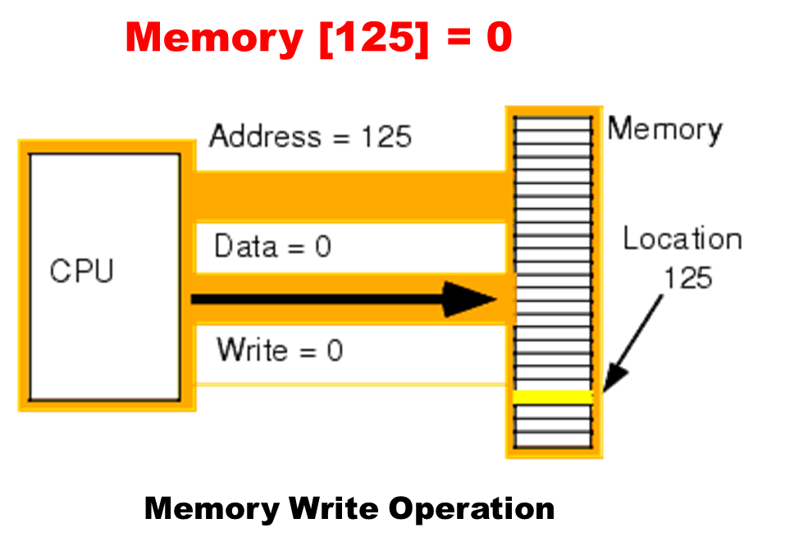
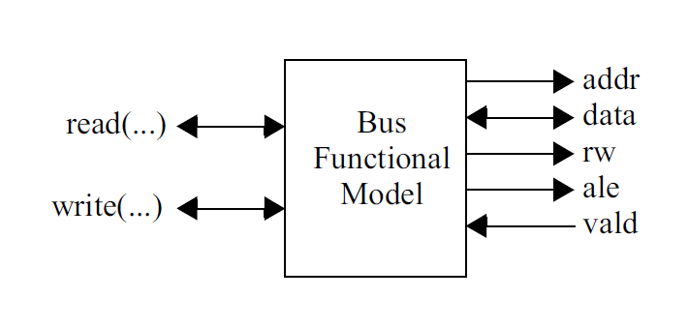
Bus Functional Model
Task write
addr
waddr
module TESTBED();
reg [5:0] addr;
wire [3:0] data;
reg [3:0] t_data;
reg [3:0] rdata;// store read data
reg rw;//0:write,1:read
reg ale;// use bus as address or data
wire valid;
task write;
input [5:0] waddr;
input [3:0] wdata;
input valid;
output [3:0] t_data;// task data
output rw, ale;
begin
if(valid != 0)
wait(valid==0);
addr = waddr;
t_data = wdata;
rw = 0;
#(10); // after 1 cycle
ale =1; // pattern send the reguest
wait(valid ==1); // design ack
ale =0;
end
endtask
task read;
input [5:0] raddr;
output [3:0] rdata;
input valid;
input [3:0] data;
output rw, ale;
begin
if(valid != 0)
wait(valid==0);
addr = raddr;
rw = 1;
#(10); // after 1 cycle
ale =1; // pattern send the reguest
wait(valid ==1); // design ack
rdata = data;
ale =0;
end
endtask
t_data
wdata
rw
ale
valid
write(6'd0, 4'd3, valid, t_data, rw, ale); //write 4’d3 to address 0
Notes:
Writing Testbenches: Functional Verification of HDL Models p. 138. Fig. 4-2

Slide 33
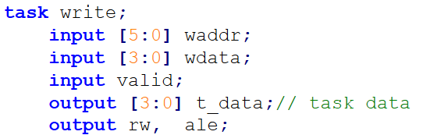
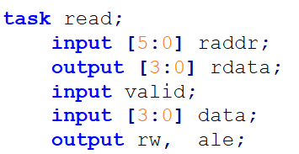
Bus_module I0(addr, data, rw, ale, valid);
assign data = (!rw)?t_data:data;
initial begin
addr = 0;
rdata =0;
t_data =0;
rw = 1;
ale =0;
write(6'd0, 4'd3, valid, t_data, rw, ale); //write 4’d3 to address 0
read (6'd0, rdata, valid, t_data, rw, ale);// rdata read
//value 3 from
//address 0
end
endmodule
Notes:
read write動作描述可以變簡單

Slide 34
TLDR: Task and Function
Model reusable code
Task
Behavior modeling=> allow delay or timing control.
Zero or more input, output, INOUT (Positional mapping)
Enable or disable task
Input values are passed into the task only once, so signals used in timing controls (such as clk) must not be inputs to the task
Function
Pure computation, or combinational logics. => no delay or timing control
One output and at least one input (Positional mapping)
Tricky way: cascade for more output value
{o1,o2,o3,o4} = my_func (a,b,c,d,e);

Slide 35
Repeat
repeat (10) begin
//重複執行10次
end
repeat (10) @(posedge clk);
// equivalent to #(10*cycle);

Slide 36
Summary: how to write your testbench
從模仿開始 start from a template example
Which test pattern style?
Simple design: manual pattern
Complex design: file I/O (use C/matlab/python code to generate pattern)
Cycle related design
Use a behavior model

Slide 37
Information display and file I/O

Slide 38
Information Display
Display system task (once per call): display data to monitor
$display ,$write, and $strobe
Similar to printf in C
Continuous display if signal changes (for text only era)
$monitor
Outdated with signal dump with fsdbdumpvars for waveform
File I/O
Very primitive for Verilog-1995
Whole file read/write to/from memory: $readmemh, $writememh
$fdisplay..,
very limited for file input
Use Verilog-2001 file I/O style (basically equal to C file I/O)

Slide 39
$display $monitor (text mode debug)
Similar to printf in C
$display (display once when executed once)
$display automatically prints a new line to the end of its output
$display ([“format_specifiers”,] <argument_list>);
$display("Hello world")
$display ($time,,“%b %h %d %o”, sig1, sig2, sig3, sig4);
0 6 7 8 9
$monitor (always display if being executed)
$monitor ($time,,“%b %h %d %o”, sig1, sig2, sig3, sig4);
0 6 7 8 9
1 7 5 4 2
$monitoron, $monitoroff, turn on or off monitor

Slide 40
Display Information (cont.)
The following escape sequences are used for display special characters, similar to C language
The following table shows the escape sequences used for format specifications
\n | New line character | \” | “ character
\t | Tab character | \o | A character specified in 1-3 octal digits
\\ | \ character | %% | Percent character
specifier | Display format | specifier | Display format
%h or %H | Hexadecimal | %m or %M | Hierarchical name
%d or %D | Decimal | %s or %S | String
%o or %O | Octal | %t or %T | Current time
%b or %B | Binary | %e or %E | real number in exponential
%c or %C | ASCII character | %f or %F | Real number in decimal
%v or %V | Net signal strength
Default display mode: $display: decimal, $displayb:binary, $displayo: octal,$displayh: hexdecimal
Apply to $monitor, too

Slide 41
File I/O (Similar to C)
integer in,out,mon;
initial begin
in = $fopen("input.txt","r");
out = $fopen("output.txt","r");
mon = $fopen("monitor.txt","w");
end
// DUT input driver code
initial begin
repeat (10) @ (posedge clk);
while (!$feof(in)) begin
@ (negedge clk);
statusI = $fscanf(in,"%h %h\n",din[31:16],din[15:0]);
end
http://www.asic-world.com/verilog/verilog2k3.html
Notes:
注意：用$fopen打開文件會將原來的文件清空，若要讀數據就用$readmemb,$readmemh就可以了，這個語句不會清空原來文件中的數據
檔案開啟,主要用來開啟檔案，並取得file handle

Slide 42
repeat (10) @ (posedge clk);
$fclose(in);
$fclose(out);
$fclose(mon);
#100 $finish;
end
// DUT output monitor and compare logic
always @ (posedge clk)
if (valid) begin
$fwrite(mon,"%h %h\n",dout[31:16],dout[15:0]); //no fprintf in SystemVerilog
statusO = $fscanf(out,"%h %h\n",exp[31:16],exp[15:0]);
Close files
$fwrite() similar to fprintf()
$fwrite does not insert a newline at the end. $fdisplay does.
$fdisplay(file, "Hello World"); is the same as $fwrite(file, "Hello World\n");

Slide 43
Enhanced File I/O and String Tasks in Verilog-2001 (Similar to C)
* Open up to 2³⁰ files
* New built-in file I/O tasks:
$fgetc, $ungetc, $fgets
$fscanf, $fread,
$ftell, $fseek, $rewind, $fflush
$ferror
* New string manipulation tasks:
$swrite, $swriteb, $swriteh, $swriteo, $sformat
$sscanf
Verilog-2001

Slide 44
Verilog Specific I/O

Slide 45
$readmemh $readmemb read array
256 words x 8 bits ROM
rom.txt
module romTest;
reg [7:0] m [0:255];
reg t = 0;
wire o;
rom DUT (.i(t), .o(o));
initial $readmemb("rom.txt", m);
integer k;
initial begin
$display("Contents of Mem after reading data file:");
for (k=0; k<12; k=k+1) $display("%d:%h",k,m[k]);
end
endmodule
//Comments are allowed
1100_1100 // This is first address i.e 8'h00
1010_1010 // This is second address i.e 8'h01
@ 55 // Jump to new address 8'h55
0101_1010 // This is address 8'h55
0110_1001 // This is address 8'h56
Notes:
中間空的位置未定義
$readmem 為一個BIT的格式的讀檔函式
$readmemh 則為一個 HEX格式的的讀檔函式

Slide 46
$writememh $writememb write array
module TEST;
parameter CYCLE_NEEDED = 5000;
reg [7:0] MEMORY[0:1023];
reg CLK;
integer FILE1, i;
real CYCLE;
always #(CYCLE/2) CLK=~CLK;
……
initial begin
CYCLE = 10;
#(CYCLE_NEEDED*CYCLE)
$writememb (“DATA.txt”, MEMORY); //write whole memory to file
end
endmodule

Slide 47
Random Number Generation
The $random provide a mechanism for generating random numbers.
The task returns a new 32-bit random number each time it is called, its result can be positive of negative.
$random; or $random (seed);
When r > 0, the statement -- $random %r – generates a number in the range: [(-r+1) ~ (r-1)]. If you need a positive number only, you should add a pair of braces (i.e. { }) as following example.

Slide 48
$random
Random number generation
Returns as 32-bit signed integer
reg [31:0] rand1, rand2, rand3;
rand1 | = | $random; |  | // | generates random numbers
rand2 | = | $random % | 60; | // | random numbers between -59 | and 59
rand3 | = | {$random} | % 60;// |  | random positive values
 |  |  | // |  | between 0 and 59

Slide 49
$urandom_range()
語法：$urandom_range(int unsigned maxval,int unsigned minval = 0);
功能：傳回一個在maxval和minval之間的無符號整數
val = $urandom_range（7,0）；
$urandom()
語法：$urandom[(int seed)];
功能：產生偽亂數，每次調用時返回一個32位元的無符號偽亂數；
addr[32:1] = $urandom(254);//初始化生成器,獲得一個32位的亂數
addr = {$urandom,$urandom};//64位亂數
number = $urandom & 15;//4位亂數

Slide 50
Summary
Read/write whole array of data
Use $readmemb/$writememb
Read/write one by one
Use $fdisplay/$fscanf
Display on monitor
$display

Slide 51
Other High level constructs Not synthesizable, used for testbench

Slide 52
High Level Constructs
Force assign desired values for debugging
Procedural continuous assignment
Force release
Other procedural block
fork join : parallel execution
More event control
Wait
Loop control (similar to C language)
while, repeat, for

Slide 53
Verilog Test Bench

Slide 54
Verilog Test Bench
Objectives
Review the organization and simulation of a design with a complex test bench.
Learn coding styles and methods that are commonly used to create a test bench.

Slide 55
Flaws Still Make It To Silicon
≥ 70% (60% ~ 80%) of the project time today is spent in verification and 30 % in design
Each line of RTL code there is nearly 5-10 lines of verification code
50 % of chip require 1 or more re-spins
> 70% of re-spins are due to functional defects
Only 26% of ASICs achieved first silicon success in 2018 (50% functional defects)
Design size and complexity is growing rapidly
Percent of Silicon Spins with Flaws
Firmware is becoming more of an issue
Source: 1. Collett International Research
2. Tim Hopes. Hw/SW Co-verification, an IP Vendors Viewpoint, IEEE 1998
3. Adrian Evans, etc., Functional Verification on Large ASICs” 35th DAC, 1998
4. https://semiengineering.com/why-chips-die/

Slide 56
Test Bench Organization
A simple style test bench applies vectors to the design under test with the output being manually verified.
A sophisticated test bench is a self-checking test bench where the results are automatically verified.
Design Under Test (DUT)

Slide 57
Applying Stimulus
There are many ways to generate and apply stimulus to your
design. Some common techniques include:
In line stimulus, applied from an initial block
Stimulus applied from a loop or always block
Stimulus applied from an array of vectors or integers

Slide 58
(1) In Line Stimulus
In line stimulus has the following characteristics:
Variables can be listed only when their values change
Complex timing relationships are easy to define
A test bench can become very large for complex tests
module inline_tb;
reg [7:0] data_bus, addr;
wire [7:0] results;
DUT u1 (results, data_bus, addr);
initial
fork
data_bus = 8'h00;
addr = 8'h3f;
#10 data_bus = 8'h45;
#15 addr = 8'hf0;
#40 data_bus = 8'h0f;
#60 $finish;
join
endmodule

Slide 59
(2) From Loops
Stimulus applied from a loop has the following characteristics:
The same set of stimulus variables are modified in every iteration
Timing relationships are regular in nature
Code is compact
module loop_tb;
reg clk;
reg [7:0] stimulus;
wire [7:0] results;
integer i;
DUT u1 (results, stimulus);
always begin // clock generation
#2 clk = 1;
#2 clk = 0;
end
initial begin
for (i = 0; i < 256; i = i + 1)
@(negedge clk) stimulus = i;
#20 $finish;
end
endmodule
Exhaustive Test !!
8-bits; 2⁸ = 256 possiblity

Slide 60
Note: Random Number Generation
The $random provide a mechanism for generating random numbers.
The task returns a new 32-bit random number each time it is called, its result can be positive of negative.
initial begin
for (i = 0; i < 256; i = i + 1)
@(negedge clk) stimulus = i;
#20 $finish;
end
initial begin
@(negedge clk) stimulus = {$random} % 256
#20 $finish;
end
Exhaustive Test !!
Random Test !!

Slide 61
(3) From Arrays (1/2)
Stimulus applied from an array has the following characteristics:
The same set of stimulus variables are modified in every iteration
Stimulus can be read into an array directly from a file (next slide)
module array_tb;
reg [7:0] data_bus, stim_array[0:15]; // array (assume array has test vectors)
integer i;
DUT u1 (results, stimulus);
initial begin
//load array with values
#20 stimulus = stim_array[0];
#30 stimulus = stim_array[15]; // in line
#20 stimulus = stim_array[1];
for (i = 14; i > 1; i = i - 1) // from loop
#50 stimulus = stim_array[i] ;
#30 $finish;
end
endmodule

Slide 62
File Input (remind)
File Format for $readmemb and $readmemh
syntax: $readmemb("mem_file.txt",mema);

Slide 63
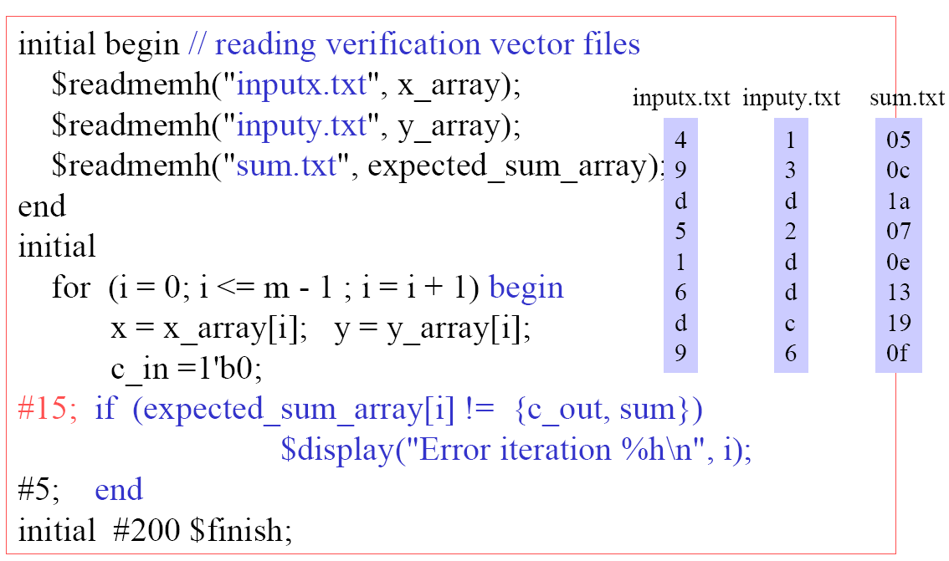
(3) From Arrays (2/2)
Digital System Designs and Practices Using Verilog HDL and FPGAs, John Wiley

Slide 64
Assignments Types
Procedural assignment (assignment within procedural blocks like always or initial)
Blocking(=) & Nonblocking(<=)
Continuous assignment (assignment outside procedural blocks)
assign
Procedural Continuous assignment (continuous assignment within Procedural Block)
Procedural continuous assignments are continuous assignments made from within a procedural block (always or initial) to a register data type.
This is not legal for most synthesis tools.
『Procedural Assignment 』 ? 『Procedural Continuous Assignment 』?

Slide 65
Procedural Continuous Assignment (1/5)
From a procedural block, you can use two types (assign/deassign and force/release) of assignments to continuously drive a value or expression on a signal.
Procedural continuous assignments are not generally synthesizable, so they are more commonly used from a testbench.
Use assign and deassign on a register, overriding any other assignments you make to that register.
initial begin
#10 assign top.dut.fsm1.state_reg = ‘init_state ;
#20 deassign top.dut.fsm1.state_reg ;
end
Use force and release on a register or net, overriding all other drivers on that signal.
initial begin
#10 force top.dut.counter.scan_reg.q = 0 ;
#20 release top.dut.counter.scan_reg.q ;
end

Slide 66
Procedural Continuous Assignment (2/5)
assign/deassign procedural
reg [3:0] q;
always@(posedge clk) begin wire q;
q <= d; assign q = d;
end
always@(set or reset) begin
if (reset) assign q = 4’h0;
else if (set) assign q = 4’hf;
else deassign q;
end

Slide 67
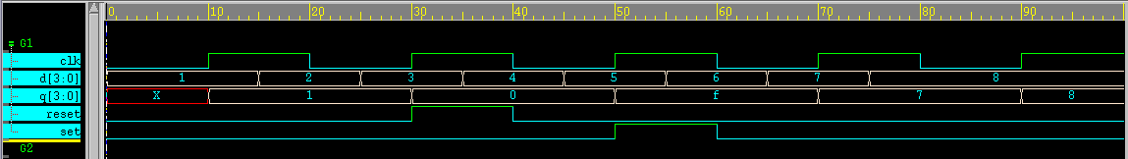
Procedural Continuous Assignment (3/5)
reg [3:0] q;
always@(posedge clk) begin
q <= d;
end
always@(set or reset) begin
if (reset) assign q = 4’h0;
else if (set) assign q = 4’hf;
else deassign q;
end
reset, set = 0,
q <= d
reset = 1,
q = 4’h0
set = 1,
q = 4’hf
reset, set = 0,
q <= d

Slide 68
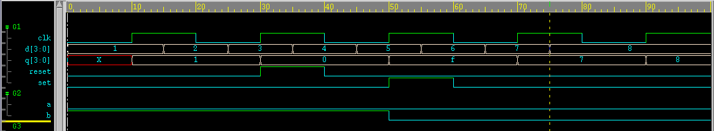
Procedural Continuous Assignment (4/5)
force/release procedural
These statements have a similar effect on the assign/deassign pair, but a force/release can be applied to nets as well as to registers
delay #50, b=0

Slide 69
Procedural Continuous Assignment (5/5)
force is used for continuously driving a value or expression on a wire/reg.
assign is used for continuously driving a value or expression on a reg.
You can force and release a bit-select, concatenation, or part-select of a signal, but not a variable bit-select (such as out_vec[i]).
You can not use assign and deassign on a bit-select or part-select of a register.
If we assign and then force a signal, it carries the force value. When you release it, the assign is still active.
Both force/release and assign/deassign procedural assignment are not synthesizable.

Slide 70
Creating Clocks (1/3)
Although they are sometimes incorporated into a design, clocks are often part of the testbench.
The next three slides demonstrate how to create different clock waveforms at both the gate level and the behavioral level.
Example 1
Here are examples of a simple symmetric clock:
we assume period is equal to 20.
reg ck;
always begin
#(period/2) ck = 1;
#(period/2) ck = 0;
end
reg go; wire ck;
nand #(period/2) u1 (ck, ck, go);
initial begin
go = 0;
#(period/2) go = 1;
end

Slide 71
Creating Clocks (2/3)
Example 2
Here is an example of a symmetric clock with a delayed startup:
we assume period is equal to 20.
reg ck;
initial
begin
ck = 0;
#(period)
forever
#(period/2) ck = !ck;
end
reg go; wire ck;
nand #(period/2) u1 (ck, ck, go);
initial
begin
go = 0;
#(period) go = 1;
end

Slide 72
Creating Clocks (3/3)
Example 3
Here is an example of an asymmetric clock with a delayed, irregular startup:
we assume period is equal to 20.
reg ck;
initial begin
#(period + 1) ck = 1;
#(period/2 - 1)
forever
begin
#(period/4) ck = 0;
#(3 * period/4) ck = 1;
end
end
reg go; wire ck;
nand #(3*period/4, period/4)
u1 (ck, ck, go);
initial begin
#(period/4 + 1) go = 0;
#(5*period/4 - 1) go = 1;
end

Slide 73
Named Blocks
You can name a block by adding: <name_of_block> after the keywords begin or fork.
module named_blk;
. . .
begin : seq_blk
. . .
end
. . .
fork : par_blk
. . .
join
. . .
endmodule
You can declare local variables in the named block.
You can disable a named block.

Slide 74
Disabling Named Blocks and Tasks
The disable statement provides the ability to terminate all the activity of a named block or a task. This means you can return from a named block or a task before all the statements are executed
Syntax:
disable <name_of_block>
or
disable <task_name>
When a named block or task is disabled, all events scheduled by it are removed from the event queue.
The disable statement is not typically supported in synthesis.
Notes:
(就是不再繼續往下執行).

Slide 75
fork join
initial begin
fork
// Time Bomb Block
begin
#5000; // Delay for 5000 time units
bomb_exploded = 1;
$display("BOOM! The bomb has exploded at time %t", $time);
$finish;
end
// Simulation Finish Check Block
begin
check_data_correct; // check data is correct or not
$display("Normal Ending.", $time);
$finish; // End the simulation
end
join
end
Two blocks executed in parallel
Simulation ending check (1) time bomb (2) normal ending
Add time bomb to avoid infinite simulation

Slide 76
Examples
Ex1: disable statement used as “goto”
begin :block_name
…
if (a == 0) disable block_name;
…
end
// end of named block
// continue with code following named block
…
Ex2: disable statement being used as an early return from a task
task proc_a;
begin
…
if (a == 0) disable proc_a; // return if true
…
end
endtask

Slide 77
Level-sensitive Timing Control
Use wait for level-sensitive timing control in behavioral code.
The following behavioral model of an adder with a latched output illustrates edge-sensitive timing with the or keyword as well as level-sensitive timing with the wait statement.
Note that wait is not synthesizable.
module latch_adder (out, a, b, enable);
input enable;
input [2:0]a,b;
output [3:0]out;
reg [3:0]out;
always @(a or b)
begin
wait (!enable) // if enable is low, perform addition
out = a + b;
end
endmodule
When still waiting, changes of a or b would be ignored.

Slide 78
Looping Statements
There are four types of looping statements. They provide a means of controlling the execution of a statement zero, one, or more times.
forever continuously executes a statement.
repeat executes a statement a fixed number of times.
while executes a statement until an expression becomes false. If the expression starts out false, the statement is not executed at all.
for controls execution of its associated statement by a three-step process, as follows :
1. initialize a variable
2. evaluates an expression
3. modify the value of the loop-control variable

Slide 79
Looping Statements: forever
The following style of behavioral clock is very flexible (you can control the start time and duty cycle) and simulates very efficiently.
A forever loop executes a statement (or block of statements) until the simulation ends.
A forever loop should be the last item in a procedural begin/end block, as any statement that followed it would never be executed.
forever loops are not synthesizable. They are generally implemented in test benches only.
...
reg clk;
initial
begin
clk = 0;
forever
begin
#10 clk = 1;
#10 clk = 0;
end
end
...

Slide 80
Looping Statements: repeat
A repeat loop executes a block of statements a fixed number of times.
The value of loop count variable is determined once at the beginning of the execution of the loop. It’s not possible to exit loop by changing the loop count variable. (see EX2)
The repeat is not efficient for synthesis, it could be used in testbench modules only.
parameter wordlength = 16;
reg CRC_valid;
initial begin
repeat ( wordlength-1) begin
CRC_valid = check ^ datai;
end
end
initial begin
count = 0;
NUM = 10;
#30 NUM = 30;
end
initial begin
repeat (NUM) begin
#10 count = count+1; // count = 10
end
end
Ex1:
Ex2:

Slide 81
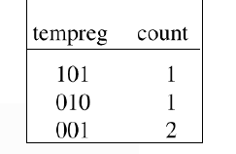
Looping Statements: while
A while loop executes a statement (or block of statements) as long as its expression is true (or nonzero).
If the expression is initially false, the statements are not executed.
The while loop is not efficient for synthesis, it could be used in testbench modules only.
reg [7:0] tempreg;
reg [3:0] count;
. . .
count = 0;
while (tempreg) // Count the ones in tempreg
begin
if (tempreg[0]) count = count + 1;
tempreg = tempreg >> 1; // Shift right
end
. . .

Slide 82
Looping Statements: for
Syntax: for (<initialization>; <condition>; <operation>)
The initialization is performed on the loop index.
The loop executes as long as the condition evaluates to TRUE.
After each time the loop executes, the operation is performed.
A simple comparison to zero often suffices in a for loop, and is usually handled much faster. However, this type of comparison may not be accepted by your synthesis tool.
// X detection
for (index = 0; index < size; index = index + 1) if (val[index] === 1'bx) // can’t use index-- or index++
$display ("found an X");
// Memory load; "!= 0" is simulated efficiently
for (i = size; i != 0; i = i - 1)
memory[i-1] = 0;
// Factorial sequence
factorial = 1;
for (j = num; j != 0; j = j - 1)
factorial = factorial * j;
!== === is not synthesizable

